Slide 1
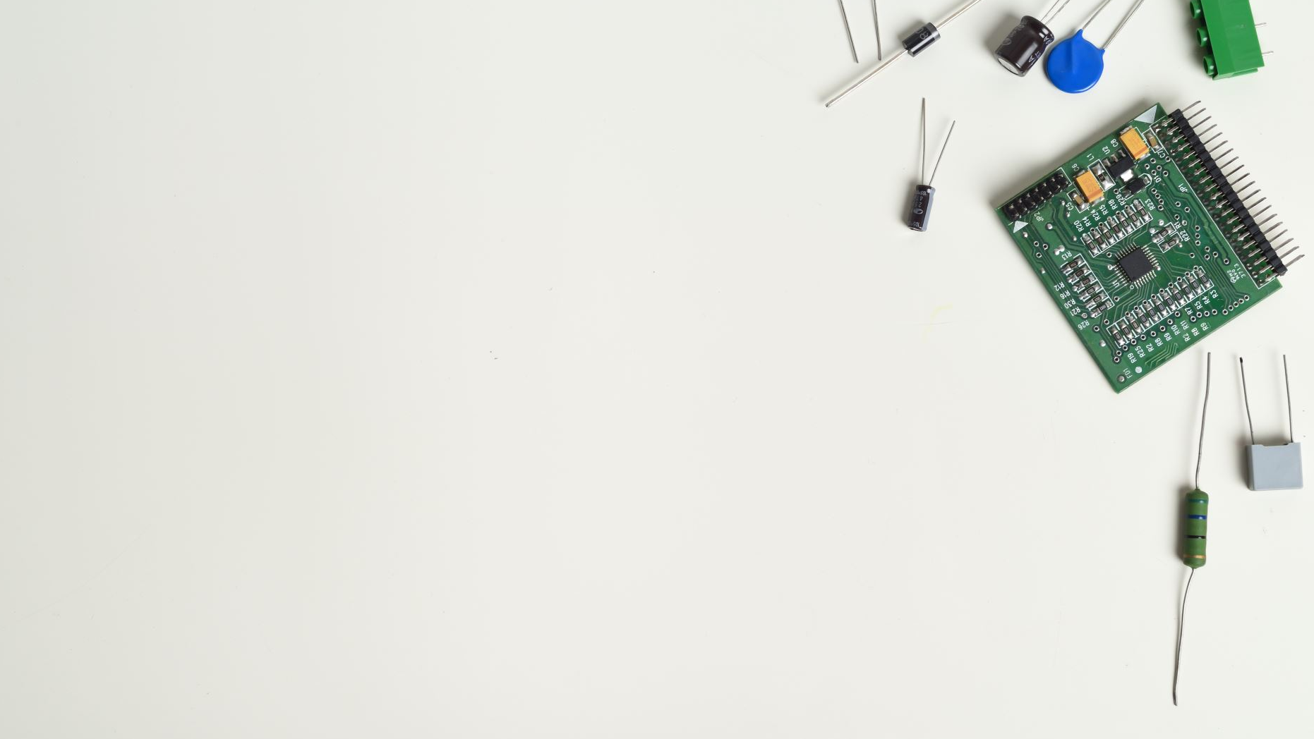
A post-mortem on developing IoT enabled devices as a small team
Sai Yamanoor

Slide 2
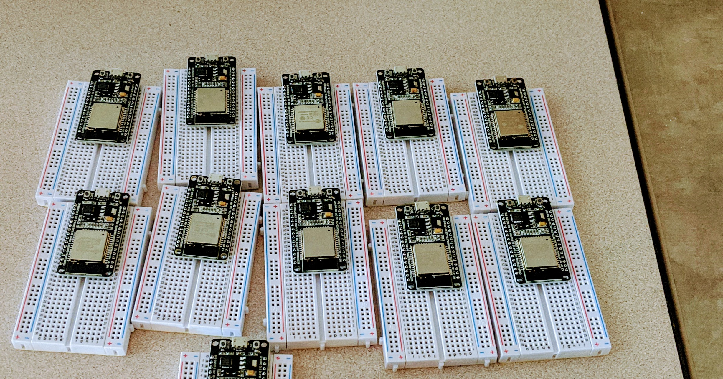
Mighty IoT with Micropython

Slide 3
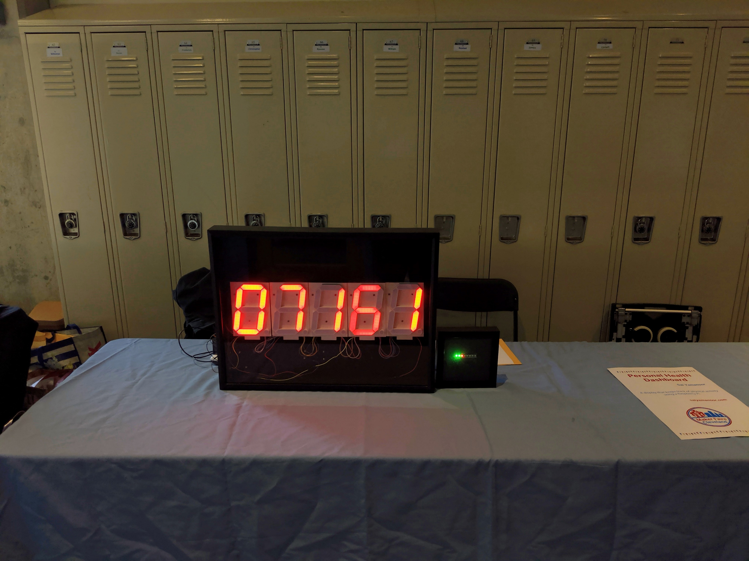
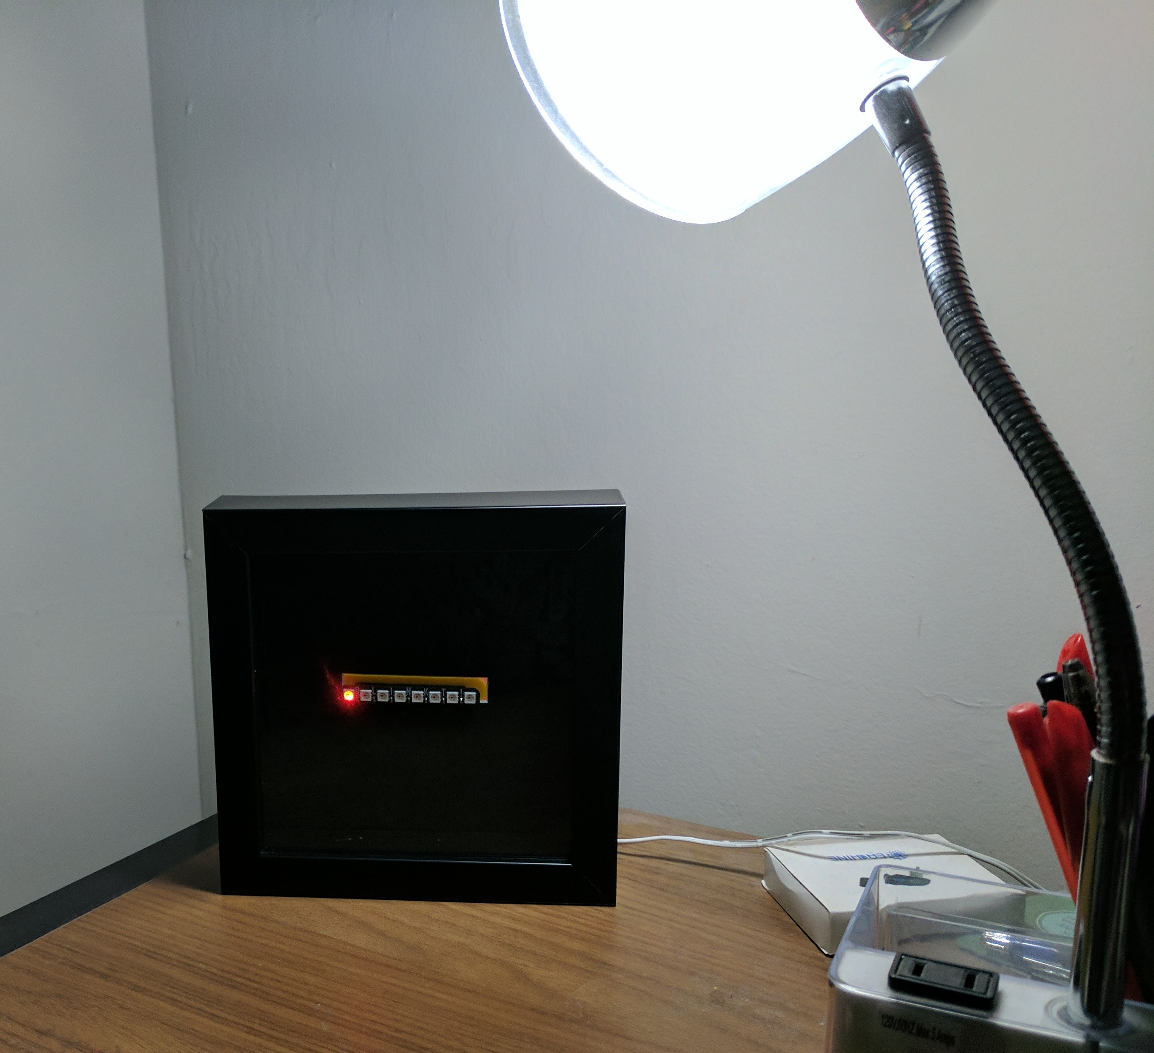
Personal Health Dashboard

Slide 4
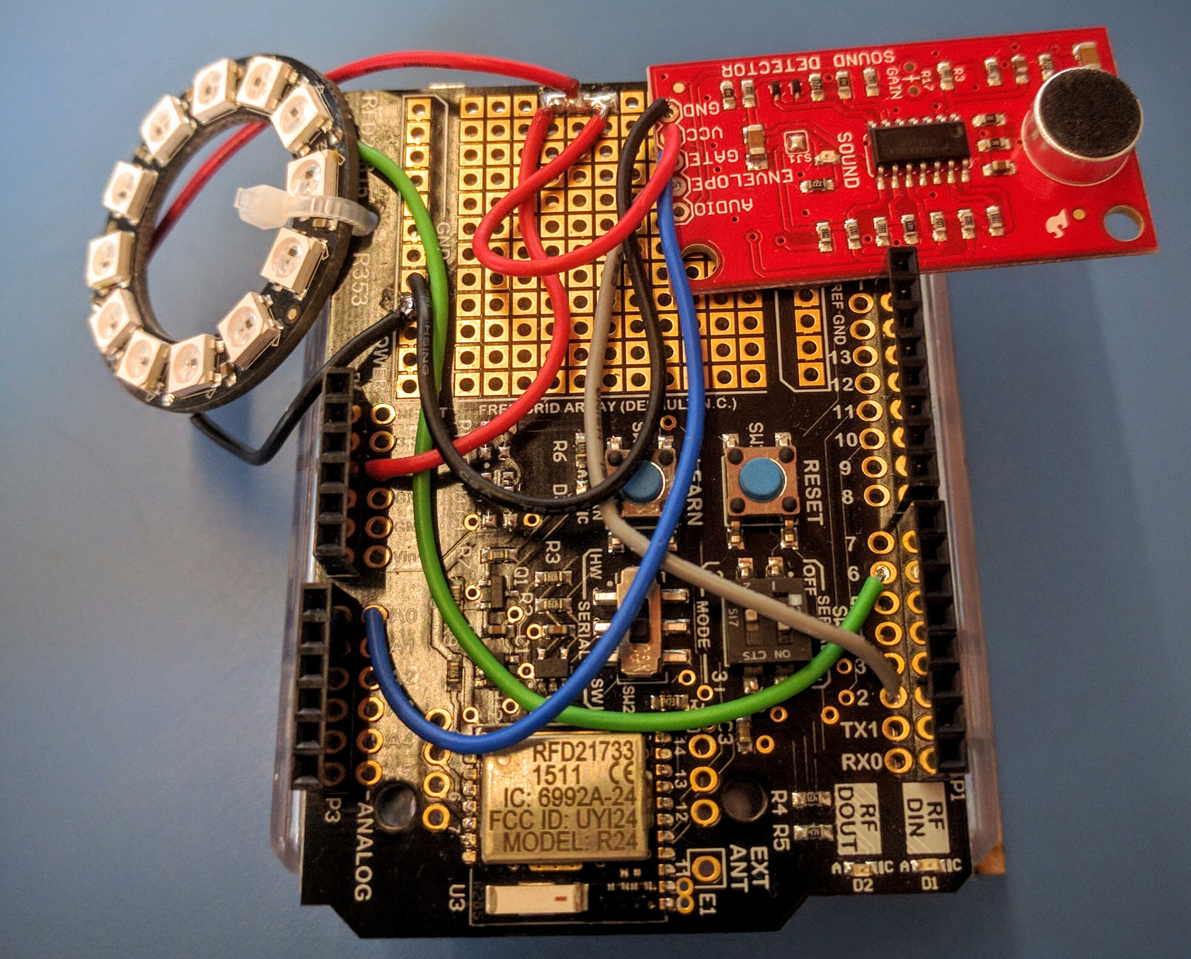
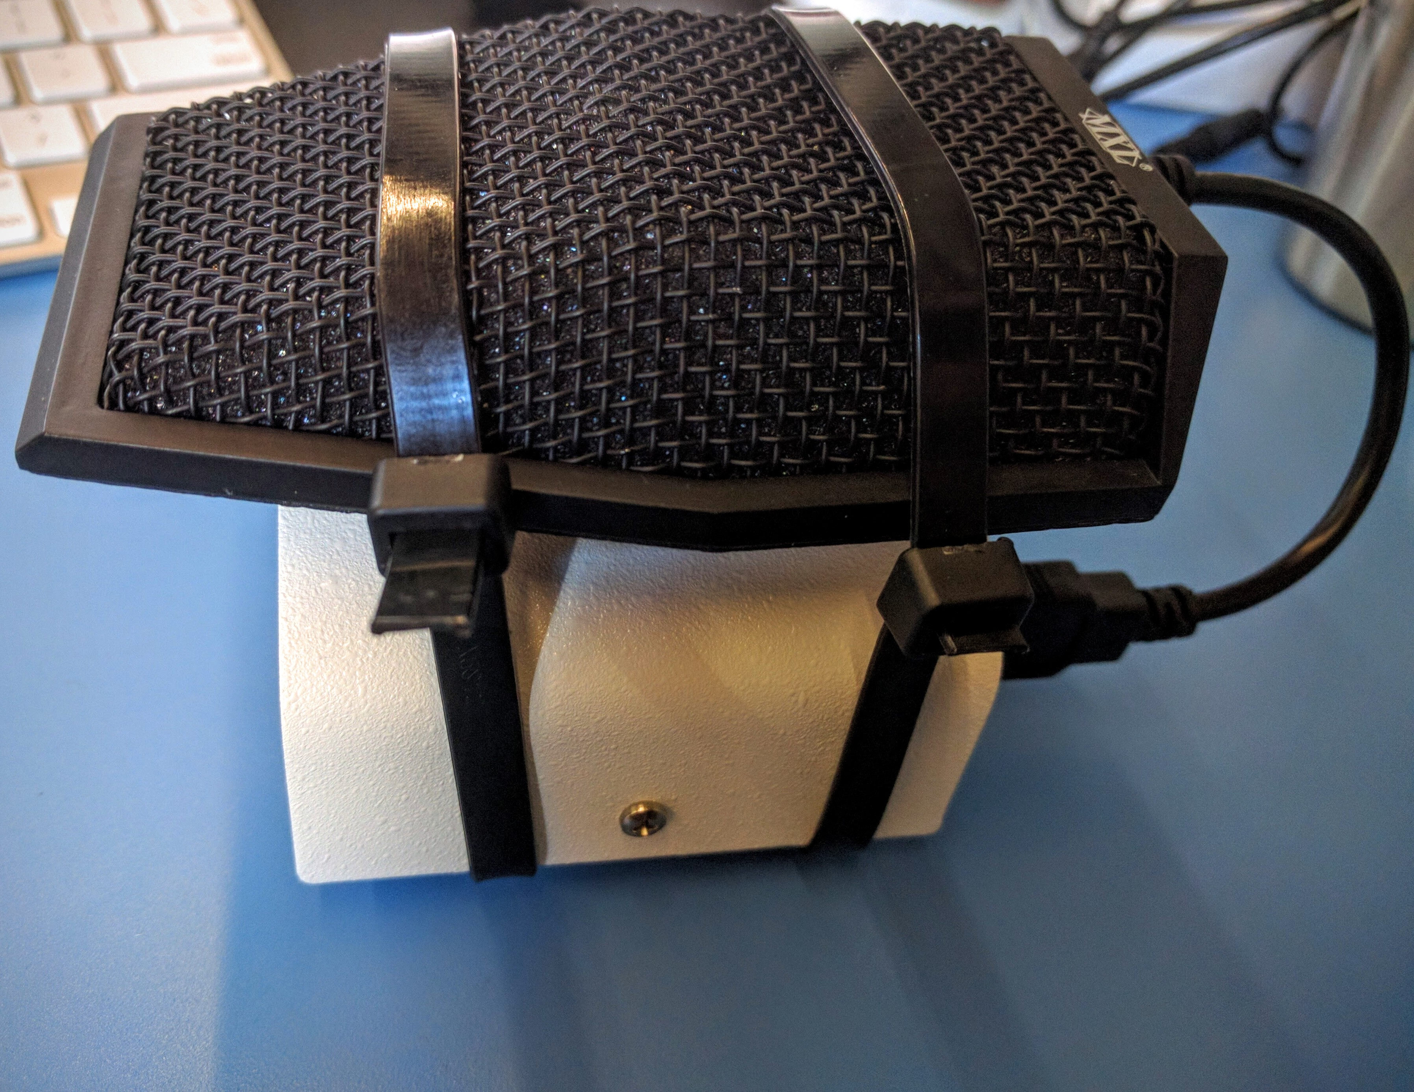
Altschool’s Sensor Sea System

Slide 5
IoT Lab @ Praxair
Two person team
Develop low cost IoT devices
Projects go through a business review process
External partner for product development

Slide 6
Situation in ‘17
Testy relationship with vendor
Exorbitant development costs
Project Delays
No Appetite for In-House Development
Well-Established Vendor @ Praxair

Slide 7
Our Approach
Keep it a secret
Off-the-shelf products for prototyping
Six months to develop a product
Project handover after development
DC adapter powered device

Slide 8
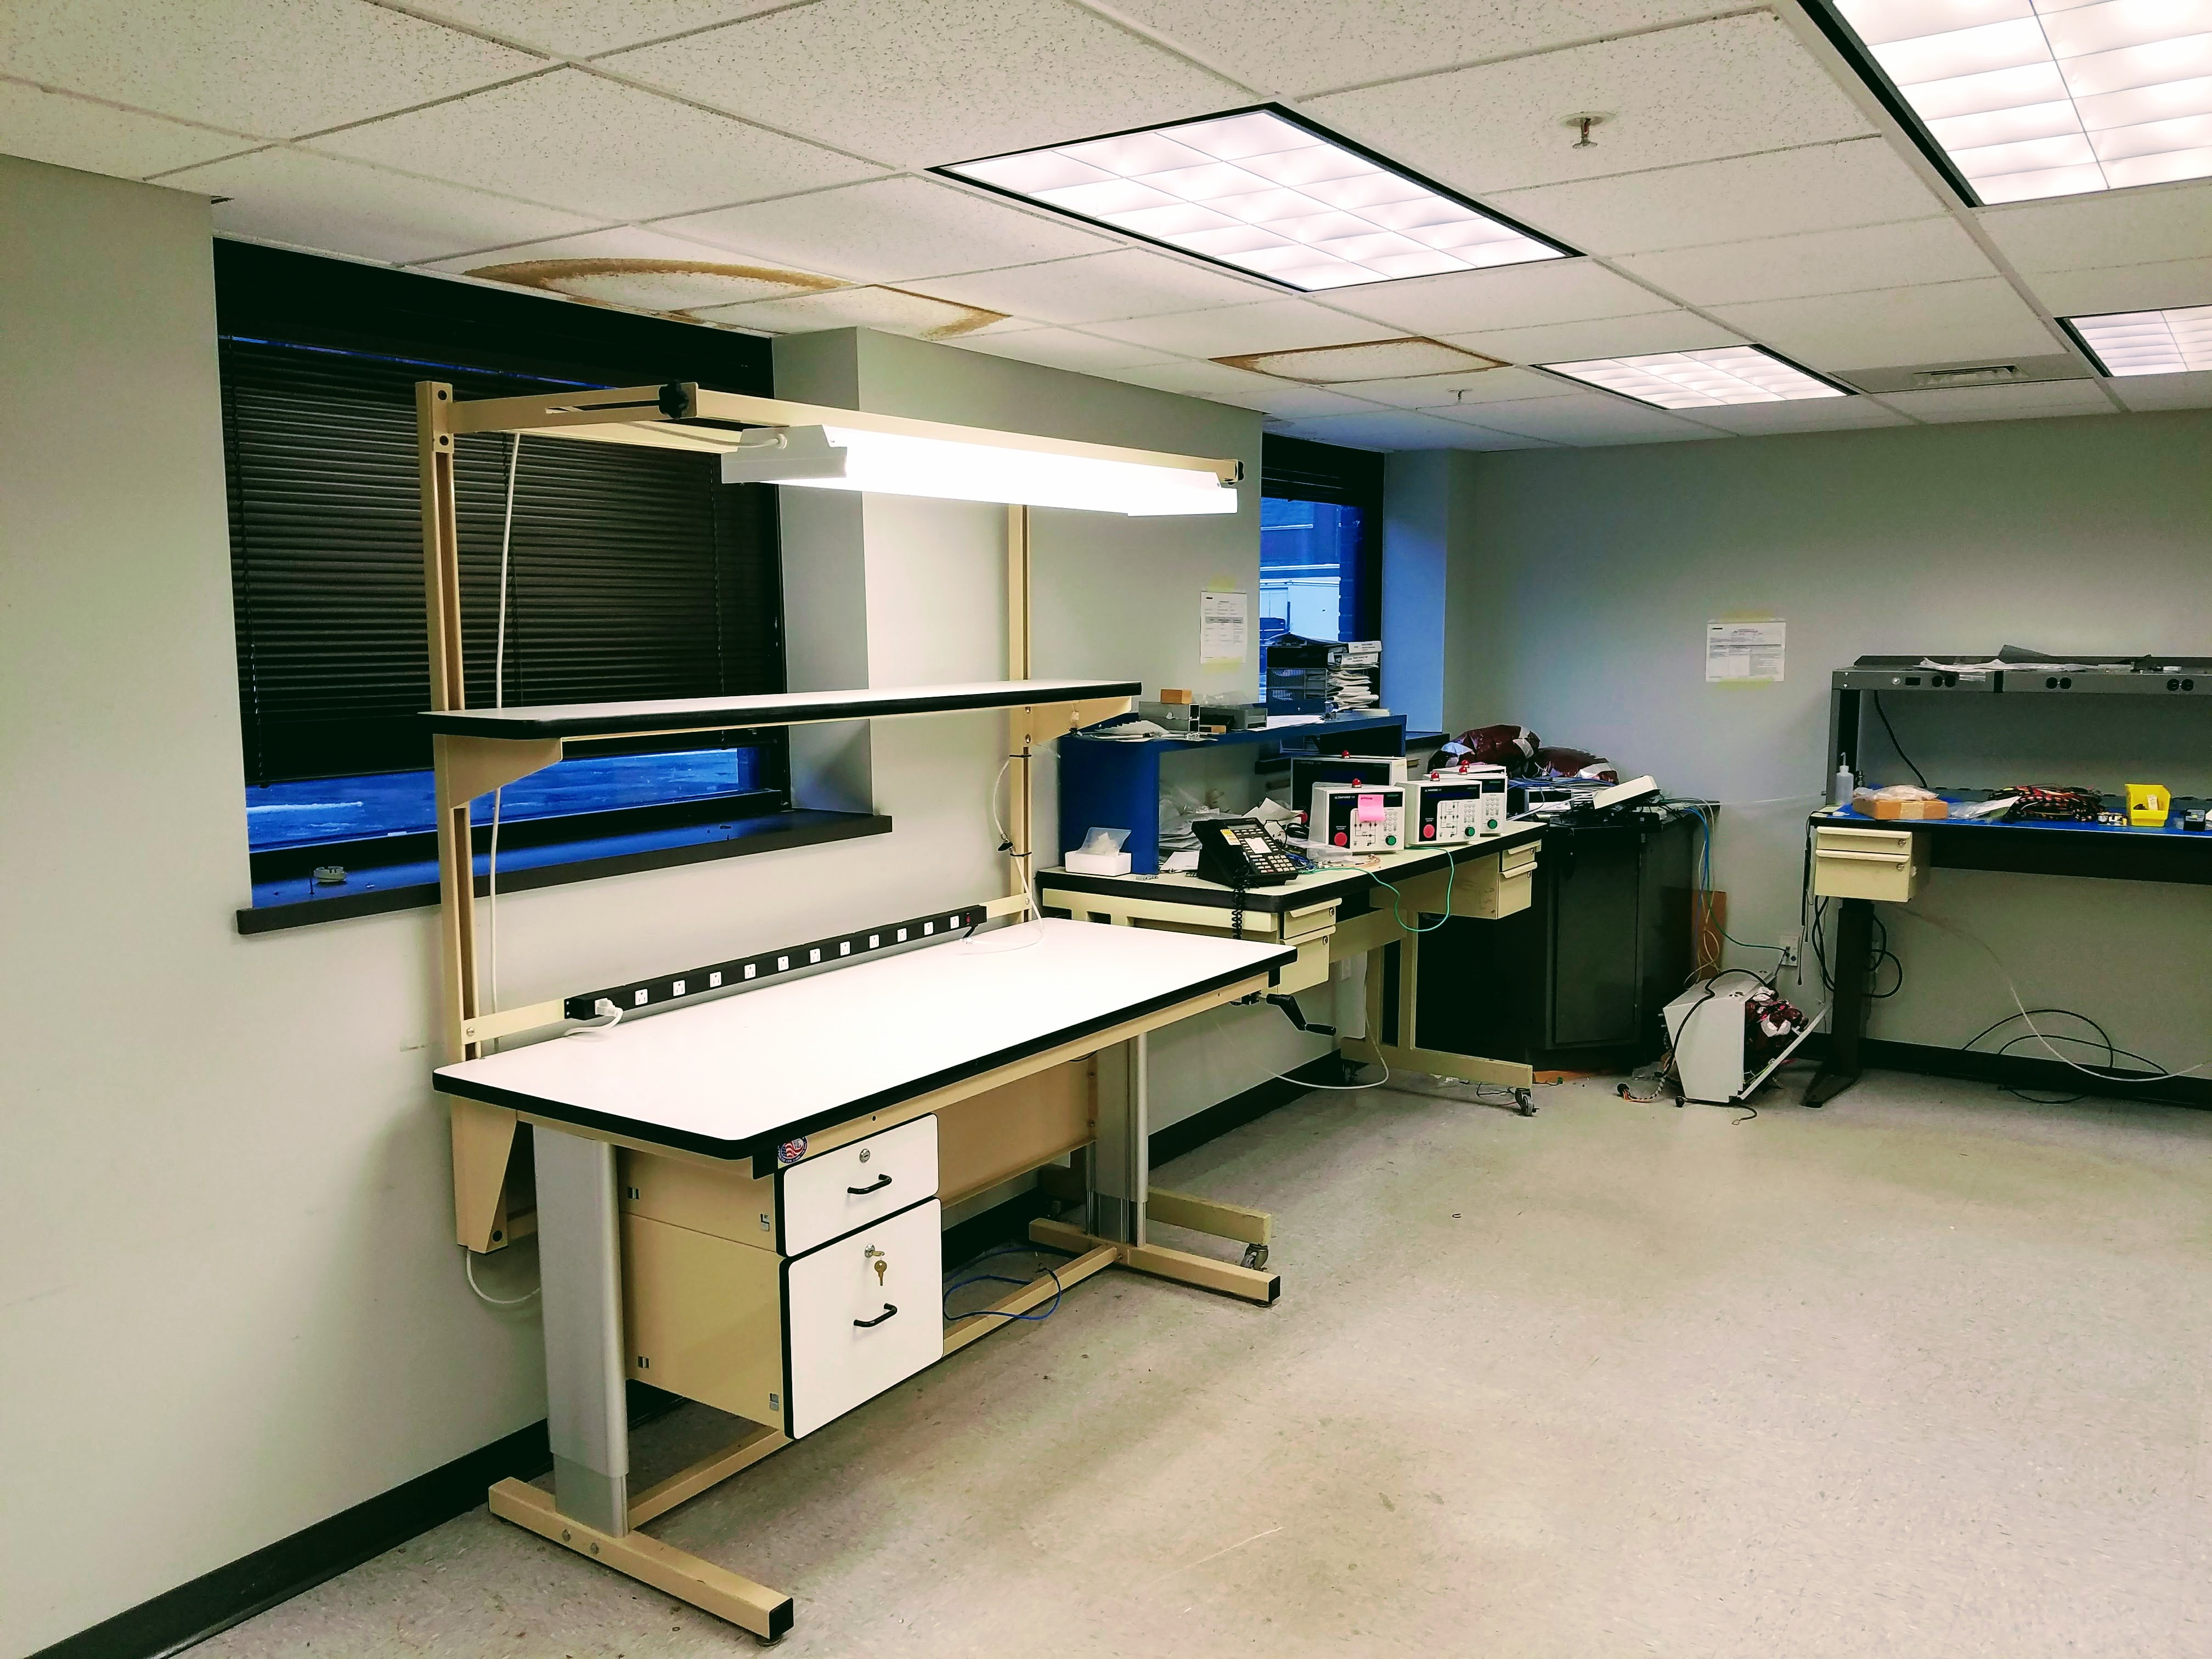
6 Months Later….
Disclosed our project to everyone
Convinced stakeholders to manufacture in-house
Established a lab at Praxair
170 Devices Manufactured and shipped to customer
Target Cost Achieved

Slide 9
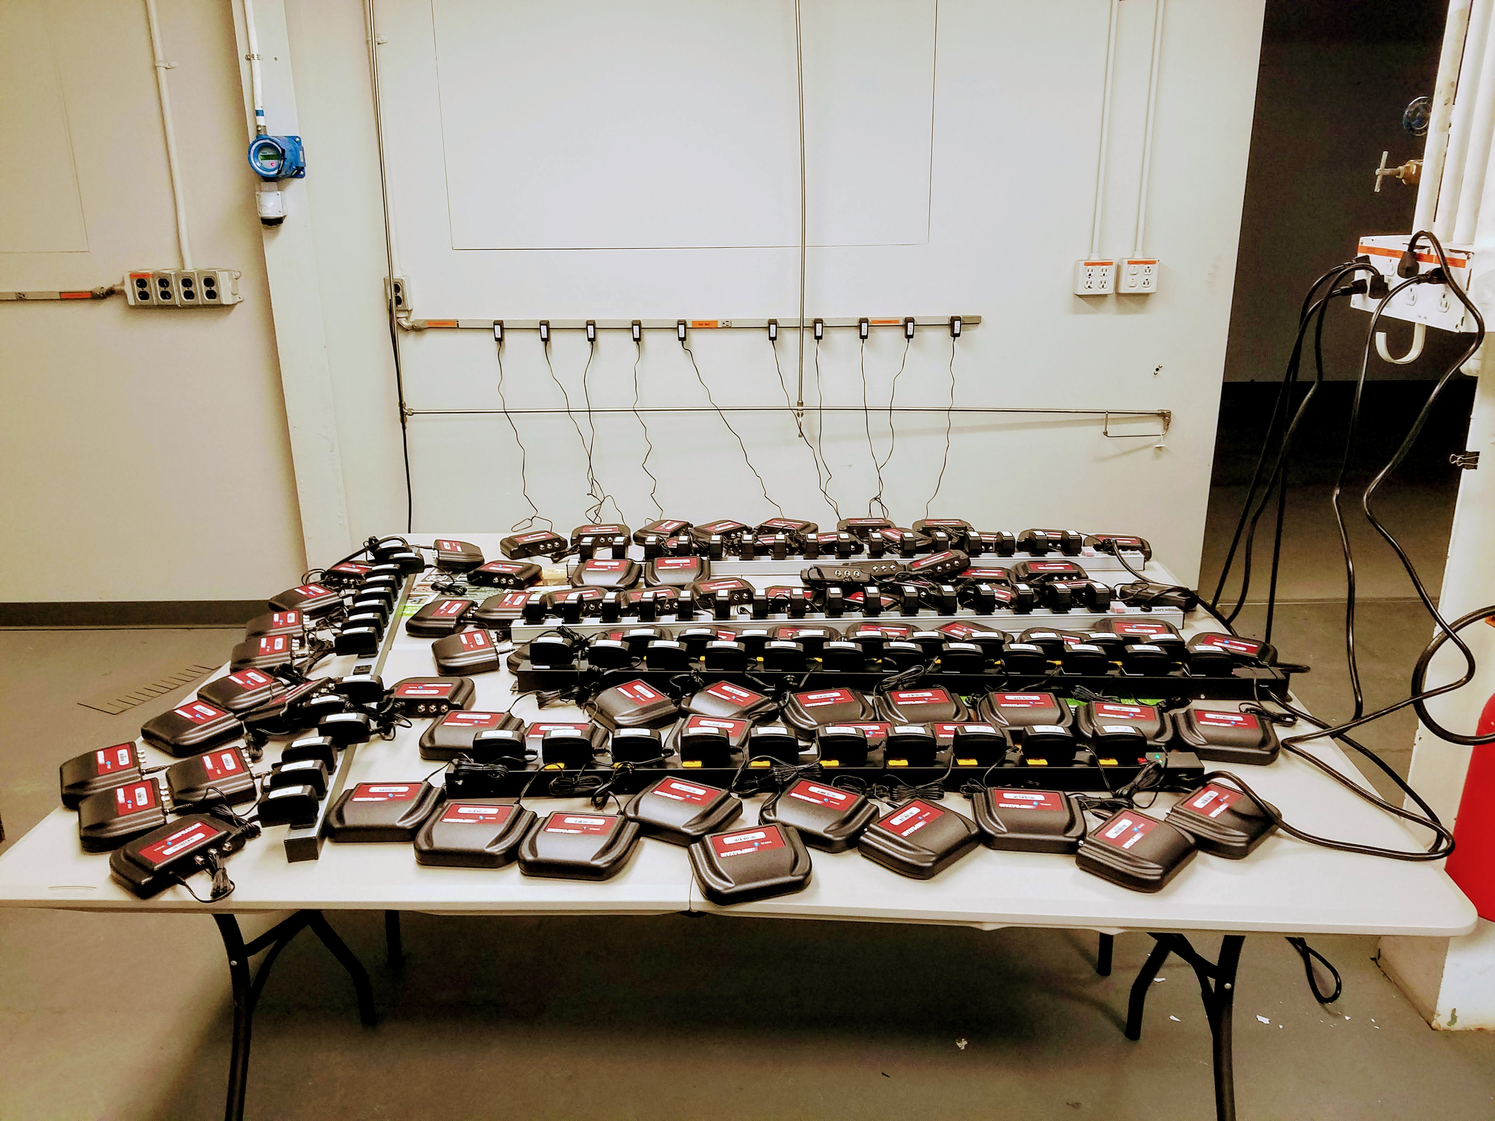
Lessons learned
Off-the-shelf hardware is the way to go
Identifying the right vendor for a specific need
Bringing vendors onboard with clear alignment of priorities
Writing clear and concise manufacturing documents
Volume is critical

Slide 10
Off-the-shelf hardware
Hardware Pricing
Relatively Stable Firmware
Excellent backend infrastructure
Recurring Charge Structure
Poor business structure
Cellular Network availability

Slide 11
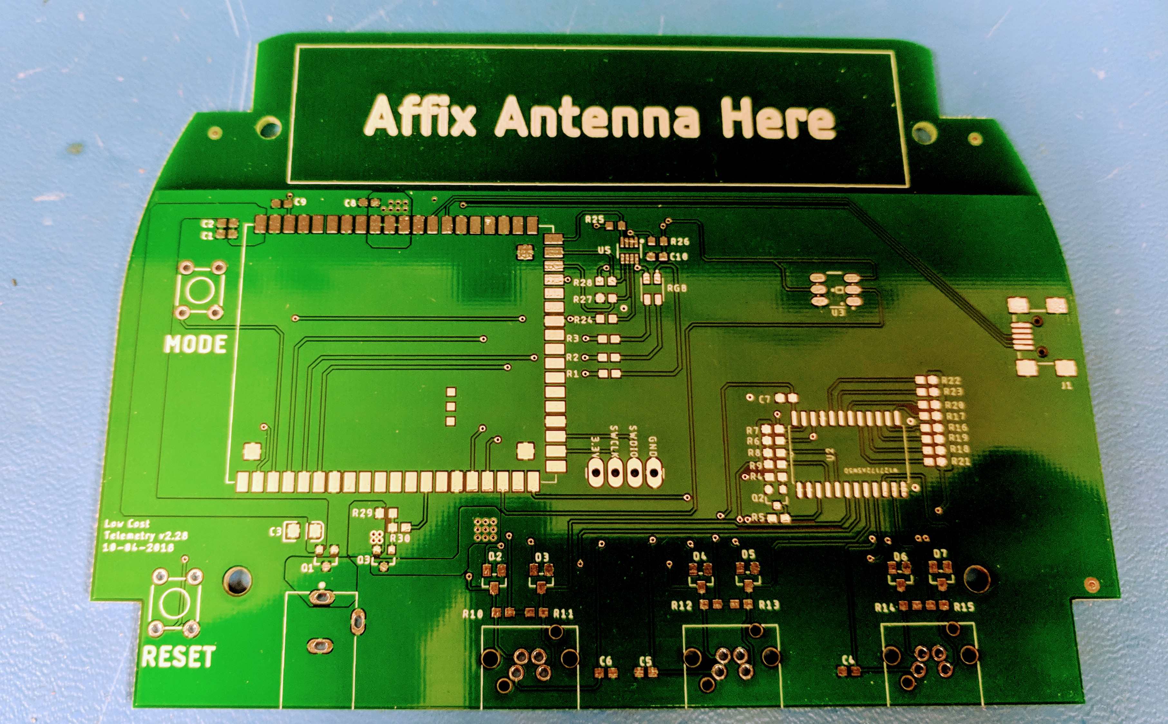
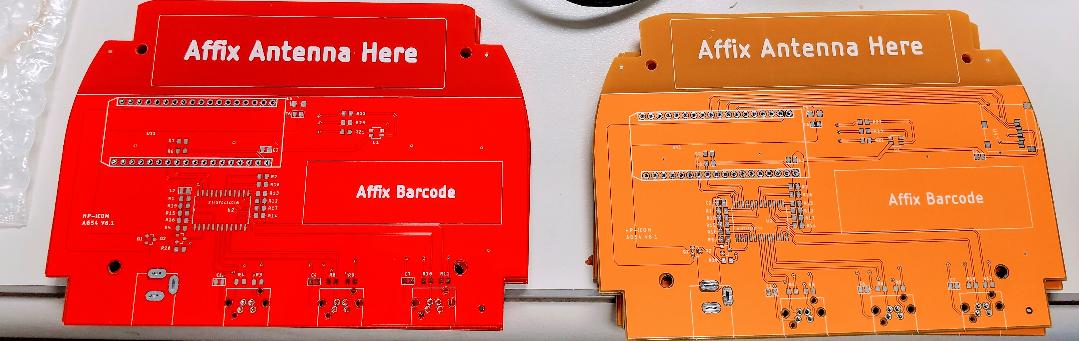
Prototyping

Slide 12
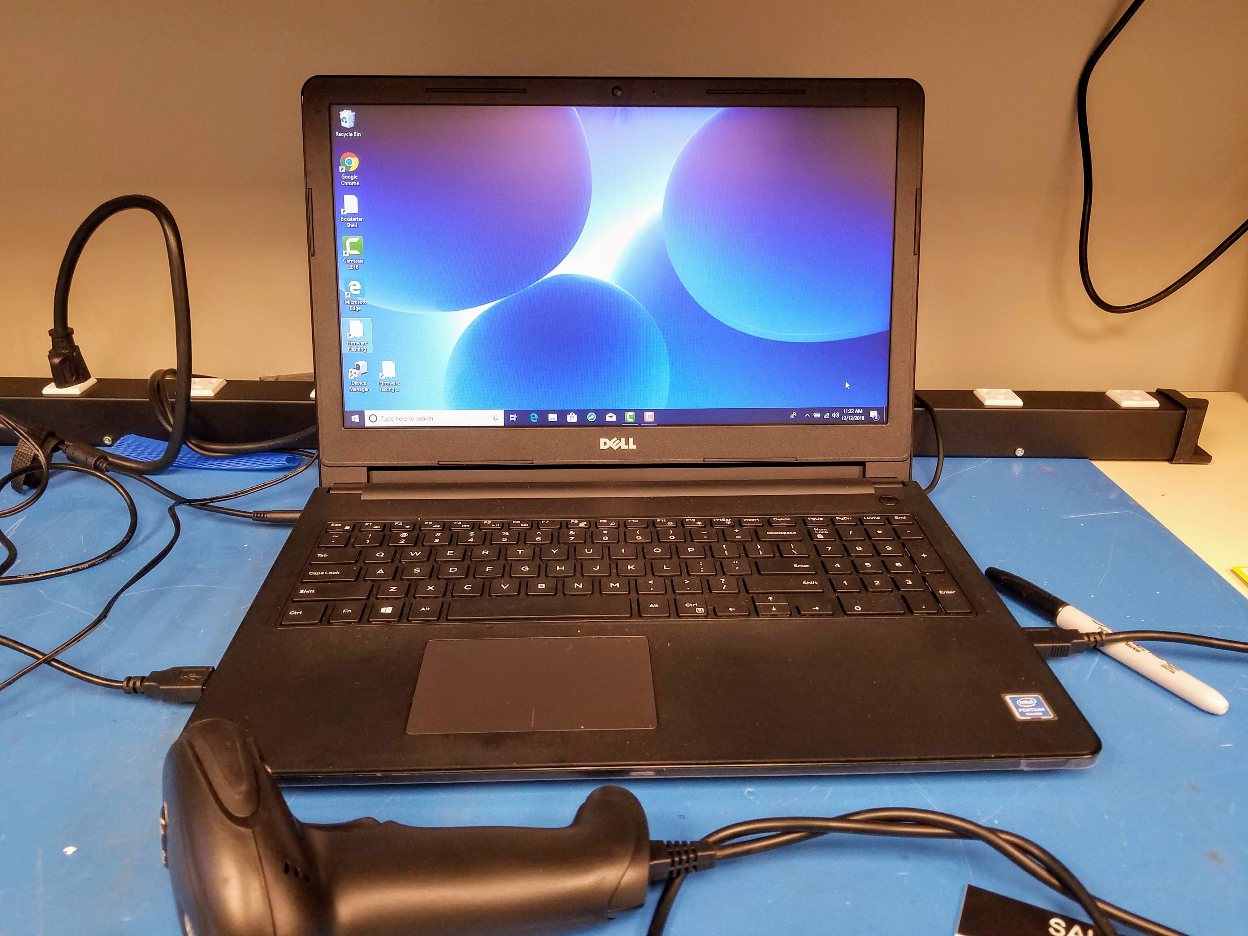
Writing Manufacturing Document

Slide 13
Third Party Tool Selection
Volume pricing
Payment/Purchase terms
Firmware/Software Stability
Ease of Deployment
International availability
Low Power Options

Slide 14
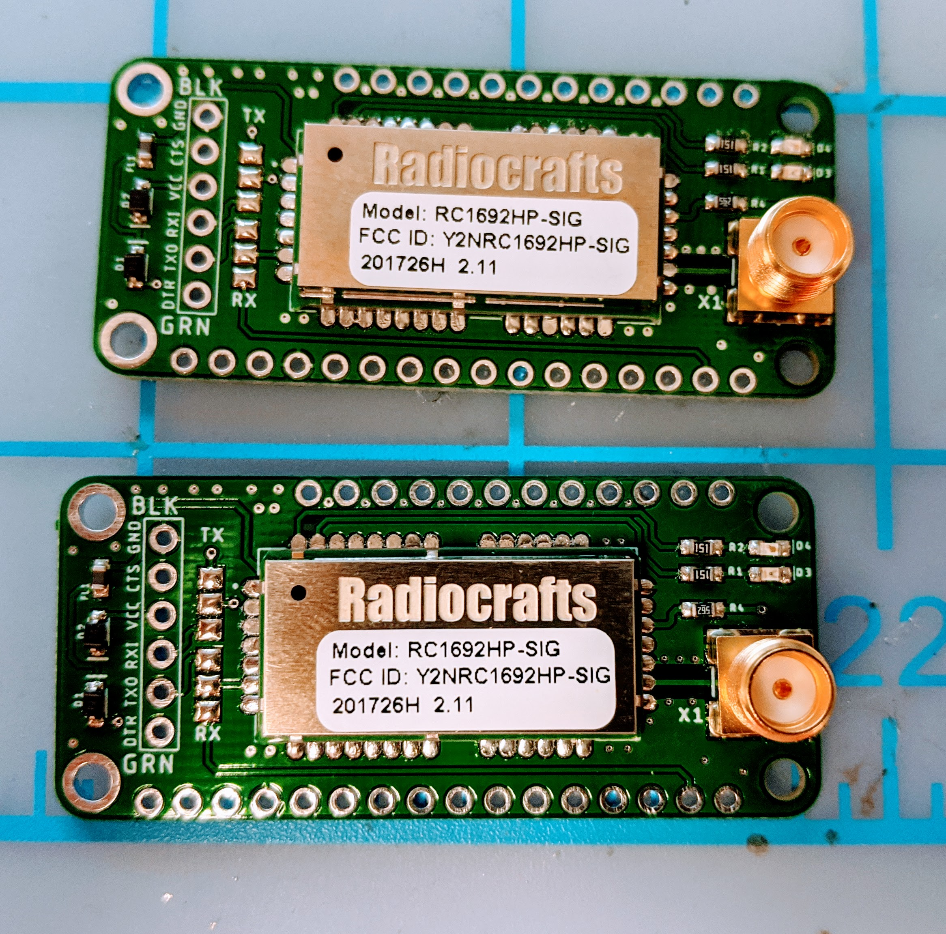
Today…
In-house development is encouraged
Previous vendor relationships on the verge of termination
Buy-in for building devices in large quantities
Identifying domestic/overseas partners for manufacturing
Developing hardware platforms for future projects

Slide 15
Technical Debt
Paying off hardware technical debt
Planning for obsolete hardware
Backwards compatibility with previous generation
Adaptability to sensors out in the field

Slide 16
Product Management
Alerts for system failures
Fiasco during Devfest trip

Slide 17
Thank you!

